Slide 1

Docker and Kubernetes Support for HTM
Presented by
Shahab Uddin 1437177
Examined by – Prof. Damir Dobric

Slide 2
Objective
The objective of this project is to run the experiment on Spatial Learning and Multisequence Learning and try to understand how they work and how to put the code in docker container.
Analyse input and output arguments and decide how to change existing experiments to run them by providing arguments as command/line arguments. Analyse the performance of both experiments and try to find out which part of the code in the SP and TM can be improved.

Slide 3
Agenda
Introduction
Containerization
Docker
Kubernetes
Command Line Arguments
2-Step Process
Result
Conclusion
References

Slide 4
Introduction
In the digital landscape, there are numerous powerful tools, each holding the potential to transform how things work. One such ground-breaking technology is, without doubt, Containerization – specifically, through Docker.
In the vast ocean of software development, containers have surfaced as the most agile units of software, packing all the prerequisites to build, ship, and deploy applications.

Slide 5
Containerization
Containerization is a software deployment process that bundles an application’s code with all the files and libraries it needs to run on any infrastructure.
Traditionally, to run any application on your computer, you had to install the version that matched your machine’s operating system. For example, you needed to install the Windows version of a software package on a Windows machine.
However, with containerization, you can create a single software package, or container, that runs on all types of devices and operating systems.

Slide 6
Docker
Docker is a software platform that allows you to build, test, and deploy applications quickly.
Docker packages software into standardized units called containers that have everything the software needs to run including libraries, system tools, code, and runtime.
Using Docker, you can quickly deploy and scale applications into any environment and know your code will run.

Slide 7
Why use Docker :
Using Docker lets you ship code faster, standardize application operations, seamlessly move code, and save money by improving resource utilization.
When to use Docker:
You can use Docker containers as a core building block creating modern applications and platforms .
How Docker works:
Docker works by providing a standard way to run your code. Docker is an operating system for containers. Similar to how a virtual machine virtualizes (removes the need to directly manage) server hardware, containers virtualize the operating system of a server.

Slide 8
Docker Key components
Docker Image
A Docker image, or container image, is a standalone, executable file used to create a container. This container image contains all the libraries, dependencies, and files that the container needs to run.
Docker Commands
Docker provides commands that are used on command line interface or build pipelines to interact with Docker runtime.
DockerContainer
A Docker container is a runtime environment with all the necessary components—like code, dependencies, and libraries—needed to run the application code without using host machine dependencies.

Slide 9
Architecture of Hypervisor & Docker

Slide 10
Dockerfile
In order to create Docker image and Docker container, we first have to create Dockerfile. The Dockerfile contains the instruction to build the application with required dependencies.

Slide 11
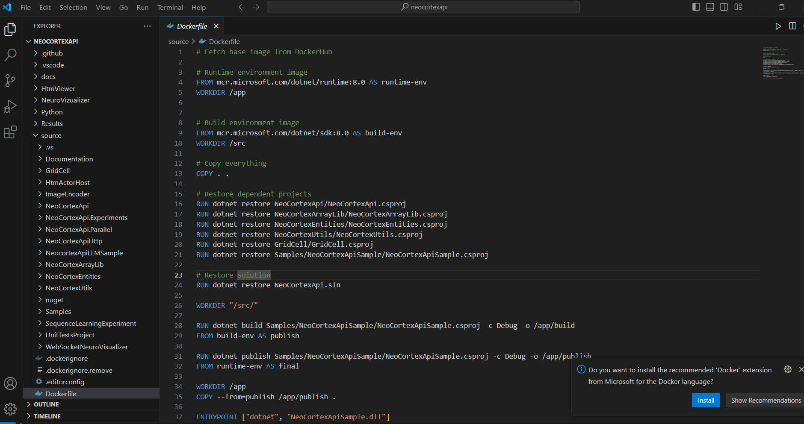
Dockerfile for neocortexapi

Slide 12
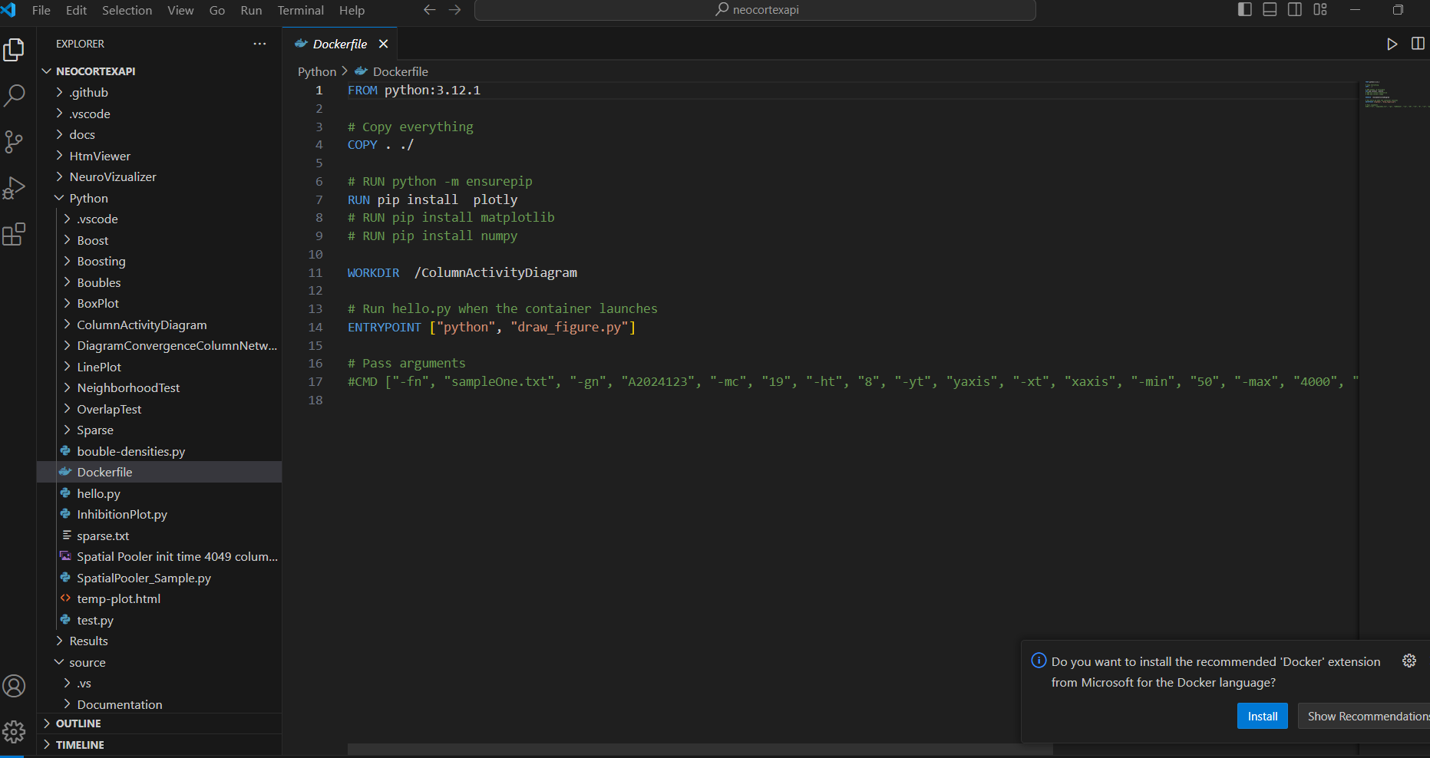
Dockerfile for draw_figure

Slide 13
Kubernetes (k8s)
Kubernetes (also known as k8s or “kube”) is an open source container orchestration platform that automates many of the manual processes involved in deploying, managing, and scaling containerized applications.
Originally developed and designed by engineers at Google as the Borg project, Kubernetes was donated to the Cloud Native Computing Foundation (CNCF) in 2015

Slide 14
Kubernetes Architecture

Slide 15
Multi Sequence Learning
Multisequence learning is an HTM-based system that learns and predicts numerous sequences of patterns at the same time. Multisequence learning involves learning and predicting each sequence of patterns using distinct Temporal Memory modules.

Slide 16
Command line arguments for different types of experiments

Slide 17
2-Step Process
There are 2 types of Dockerfile in this project.
1. One for neocortexapi to generate SDR values which is being written in a text file inside container, by default it was being written in output window of Visual Studio.
2. Second for draw_figure.py which takes the text file generated in above step as input and generate Column Activity Diagram.

Slide 18
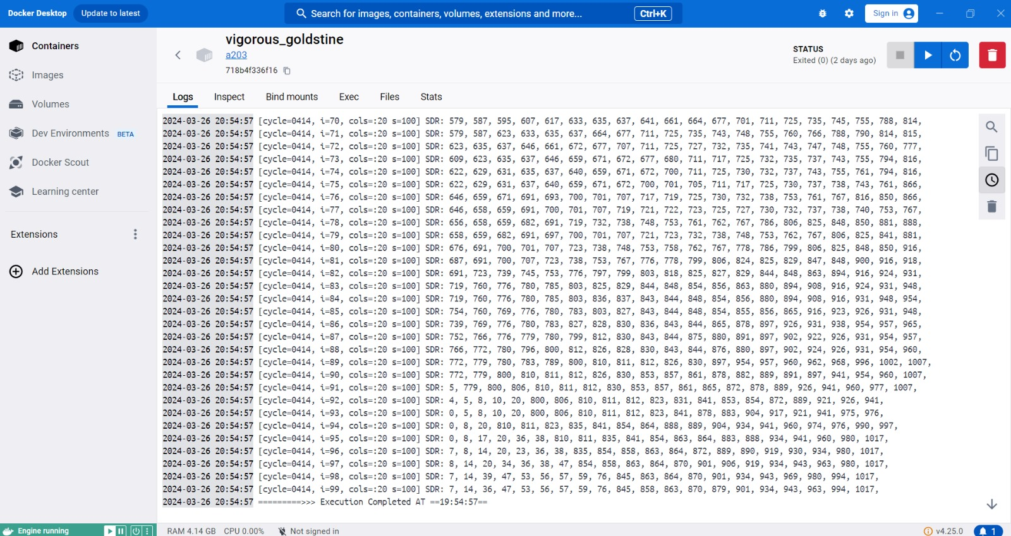
SDR values in logs (for step 1)

Slide 19
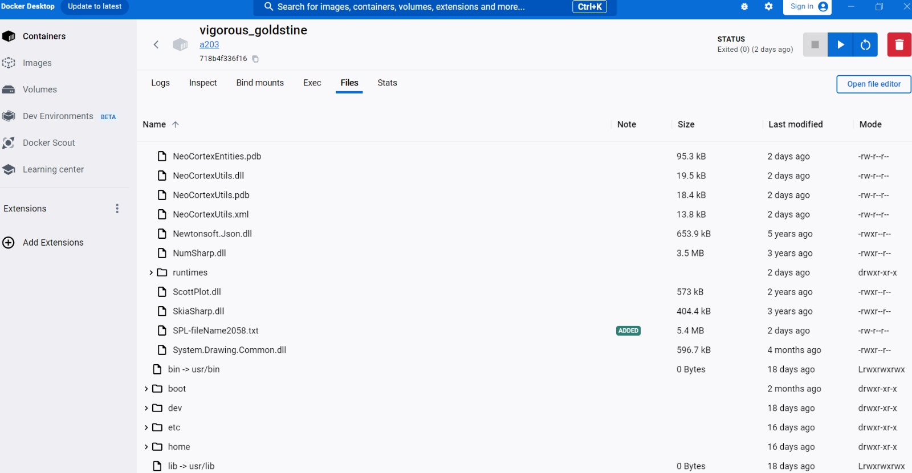
SDR values in text file (for step 1)

Slide 20
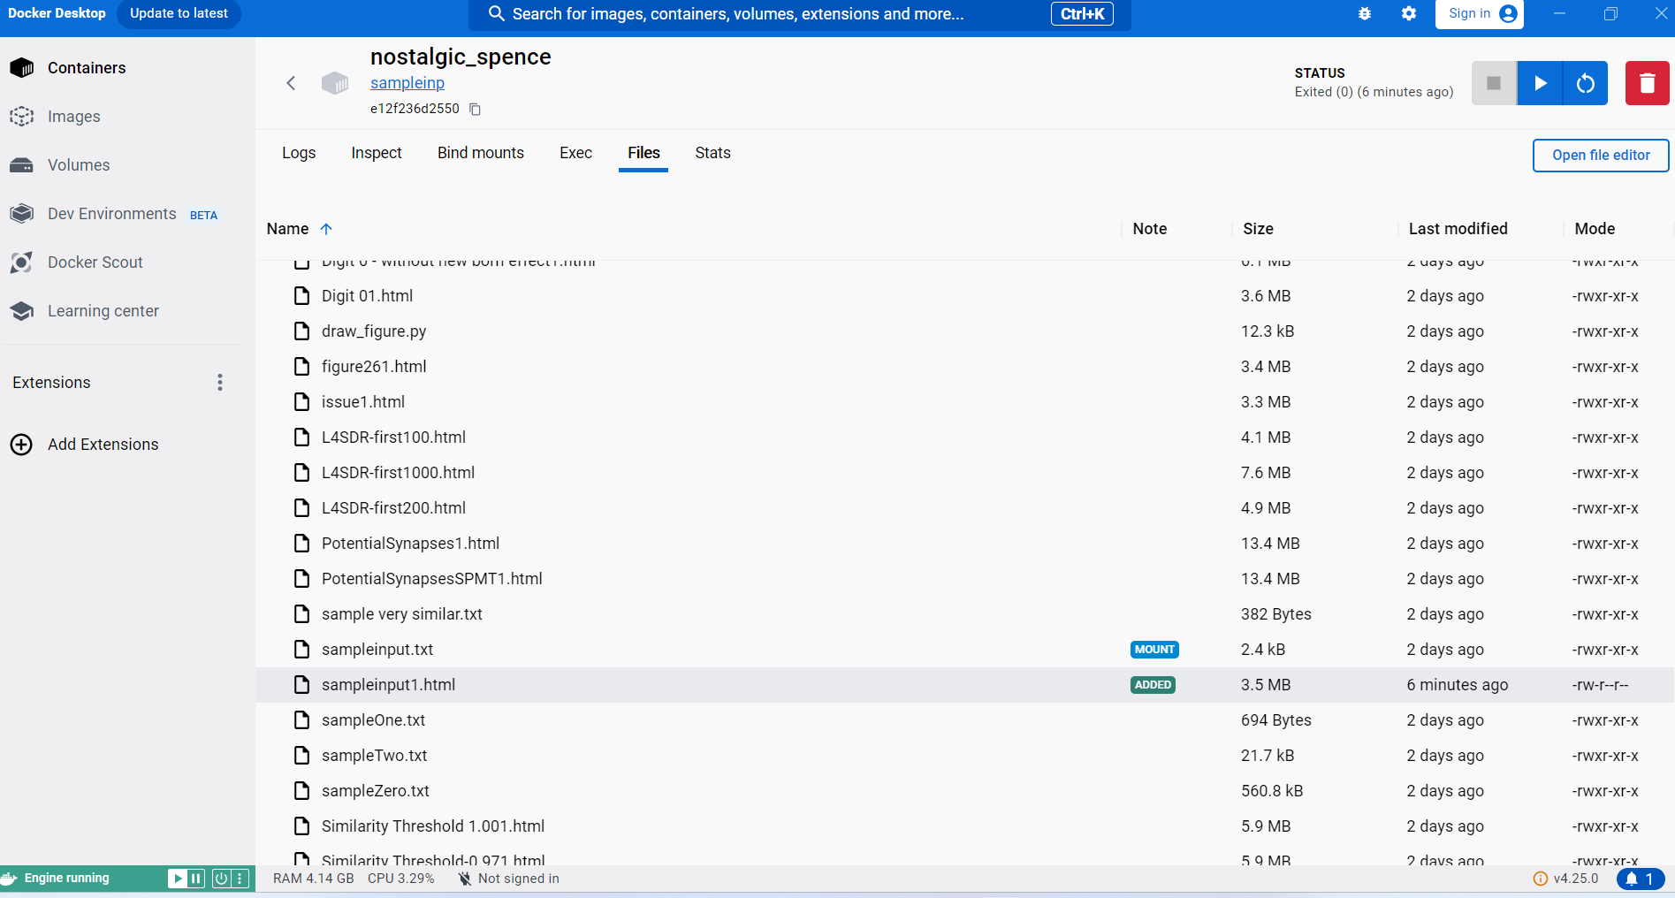
Draw_file (for step 2)

Slide 21
Column Activity Diagrams Python project takes SDR values as input and generates Column Activity Diagrams.

Slide 22
Conclusion
As described in above slides these Dockerfile can be used to run the project on any computer regardless of their host operating system e.g. Linux, Windows or MacOS
Docker images can be pushed into any Docker registry for example DockerHub or Azure Container Registery or any other cloud provider.
This implementation gives the advantages of platform independence.
This implementation also gives the advantage to scale the container as per requirements.

Slide 23
References
[1] Estrada, Z. et al. 2014, A performance evaluation of sequence alignment software in virtualized environments, in: 14th IEEE/ACM International Symposium on Cluster, Cloud and Grid Computing, (CCGrid), IEEE, 2014.
[2] Hwang, J., Zeng S. and Wood, T. 2013, A component-based performance comparison of four hypervisors, in: IFIP/IEEE International Symposium on Integrated Network Management, (IM 2013), IEEE, 2013.
[3] Pahl, C., Brogi, A., Soldani, J. and Jamshidi, P. 2019, Cloud Container Technologies: A State-of-the-Art Review, IEEE Transactions on Cloud Computing, Vol. 7, No. 3.
[4] Soltesz, S. et al. 2007, Container-based operating system virtualization: a scalable, high-performance alternative tohypervisors, SIGOPS Oper. Syst. Rev. 41 (3) 275–287.
[5] Varrette, S. et al. 2013, HPC performance and energy-efficiency of Xen, KVMand VMware hypervisors, in: 25th International Symposium on Computer Architecture and High Performance Computing, (SBAC-PAD), IEEE, 2013.
[6] Abdellatief, E., Abdelbaki, N. 2013, Performance evaluation and comparison of the top market virtualization hypervisors, in: 2013 8th International Conference on Computer Engineering & Systems, (ICCES), IEEE

Slide 24
Thank you

